Slide 1

R.V.R & J.C College of Engineering Chowdavaram,Guntur,A.P.
Team number-22
Classification of Lung and Colon Cancer Histopathological
Images Using Global Context Attention Based Convolutional
Neural Network
Guide Name : Sri. N.Chandra Sekhar
TEAM MEMBERS:-
Y21CS182 V AKSHAY SAI
Y21CS184 V SAI PHANINDRA
Y21CS170 T VENKATA NARAYANA

Slide 2
AGENDA:-
Team number-22
ARCHITECTURE
METHODOLOGY
IN DETAIL ABOUT METHODOLOGY
ALGORITHUM USED
DETAILS OF DATASETS
EXPERIMENTAL SETTINGS
ANALYSIS OF RESULTS
ADVANTAGES
CONCLUSION
REFERENCES

Slide 3
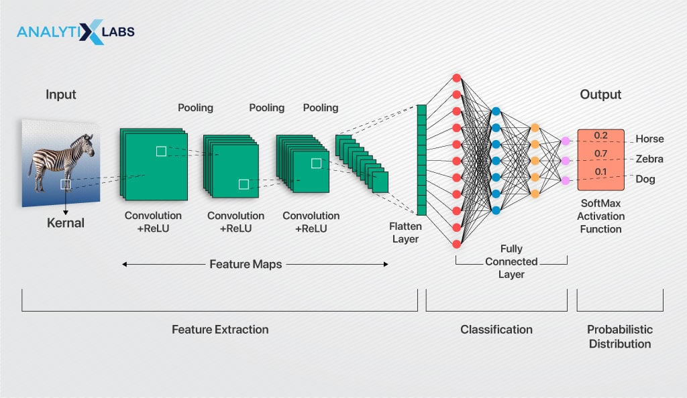

Slide 4
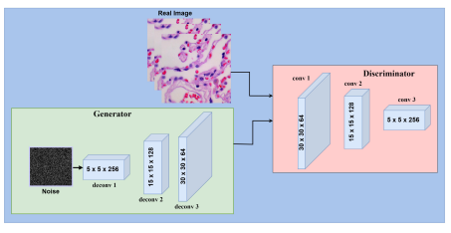
Fig:-Proposed generative adversarial network architecture consisting of generator and discriminator.

Slide 5
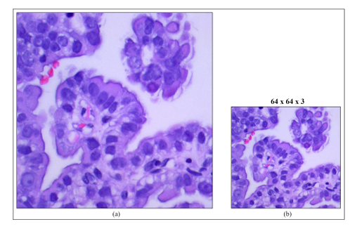
Fig:-Example of resizing. (a) : Original image. (b): Resized image.

Slide 6
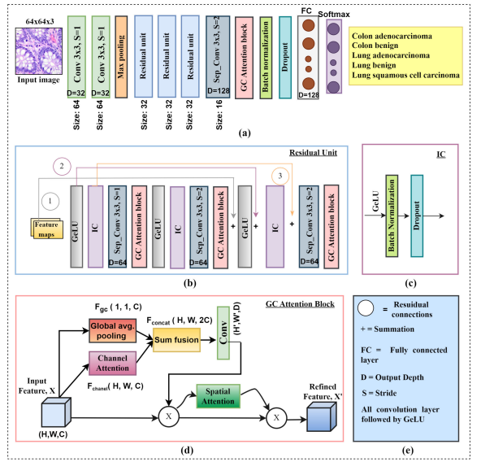
Team number-22
ARCHITECTURE:-
Fig:- The overall framework of the proposed method. (a) CNN baseline architecture. (b) Reformulating residual unit. (c) IC layer. (d) GC attention block. (e) Key showing important components.

Slide 7
METHODOLOGY-MODULE PROPOSED:-
Team number-22
Global Context Attention-Based Convolutional Neural Network (GCACNN):-
This methodology combines a CNN architecture with a specialized Global Context (GC) Attention Module to enhance feature extraction for improved classification of lung and colon cancer images.

Slide 8
DETAILS OF PROPOSED TECHNIQUES:-
1. CNN Architecture for Feature Extraction:
The CNN backbone extracts both low-level features (edges, textures) and high-level features (patterns, objects) from histopathological images. It consists of multiple convolutional and pooling layers that hierarchically capture and reduce spatial dimensions, aiding in the differentiation of cancerous and non-cancerous tissues.
2. Integration of the GC Attention Module:
The GC Attention Module enhances the CNN by focusing on the most informative regions through Channel Attention (prioritizing relevant features like color and texture) and Spatial Attention (focusing on important areas, such as tumor regions). This improves the model’s ability to detect cancerous tissues while reducing noise from irrelevant regions.
3. Global Context (GC) for Semantic Information:
The GC attention module captures global context by analyzing the entire image or significant portions, enabling the model to understand broader spatial relationships. This helps differentiate complex patterns, such as benign vs. malignant tumors, by considering contextual information beyond local pixel similarities.
4. Final Classification:
The enhanced features from the CNN and GC Attention Module are processed through fully connected layers for final classification. The output layer uses a softmax or sigmoid function to predict whether the image is cancerous or non-cancerous, or to classify the type of cancer in multi-class problems.

Slide 9
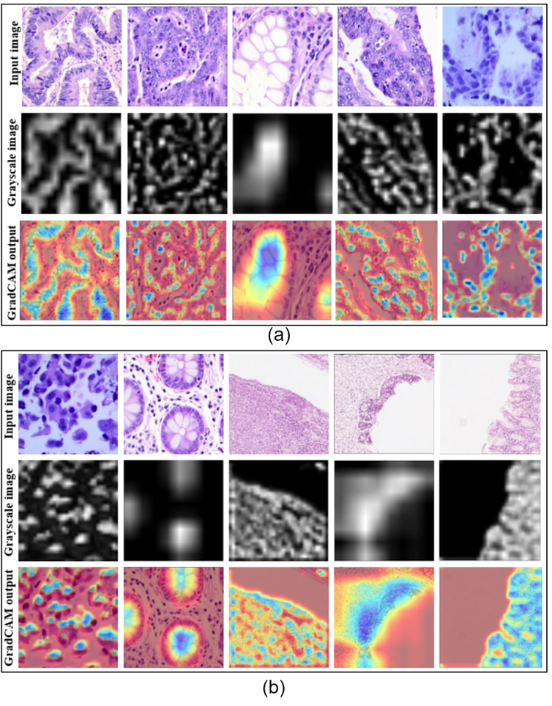
Fig:- Examples of GradCAM visualization outcome. (a) : Lung cancer samples. (b): Colon cancer samples.

Slide 10
ALGORITHUM:-
1.Import Libraries and Modules:
Import necessary libraries like TensorFlow/Keras for model building and NumPy, OpenCV for image processing.
Load and Preprocess Dataset:
Load histopathological images.
Resize and normalize images.
Apply data augmentation to increase variability and prevent overfitting.
Define CNN Model Architecture:
Build the CNN with layers such as Conv2D, MaxPooling2D, and Dense.
Add Dropout and BatchNormalization layers for regularization.
Compile the Model:
Select an optimizer like Adam.
Use categorical cross-entropy loss for multi-class classification.
Set accuracy as the evaluation metric.
Train the Model:
Fit the model on the training dataset with validation data for monitoring performance.
Evaluate the Model:
Test the model on the unseen test dataset.
Calculate accuracy and other evaluation metrics.
Save and Visualize Results:
Save the trained model for future inference.
Visualize results using confusion matrix and other relevant metrics.

Slide 11
DETAILS OF DATASETS:-
LC25000 Dataset:
Total Size : 25,000 images
Original Size : 1,250 images (expanded through augmentation)
Content : Includes both lung and colon tissue images, classified into various categories such as adenocarcinoma, squamous cell carcinoma, and benign tissues.
GLaS Dataset:
Total Size : 165 images
Content : Histological sections stained using Hematoxylin and Eosin (H&E).
CRAG Dataset:
Total Size : 193 samples
Content : 148 adenocarcinoma samples and 45 benign tissue samples from the colon.
Kather Multiclass Dataset:
Total Size : 100,000 tissue patches
Content : H&E stained tissue patches, representing multiple classes of tissue.

Slide 12
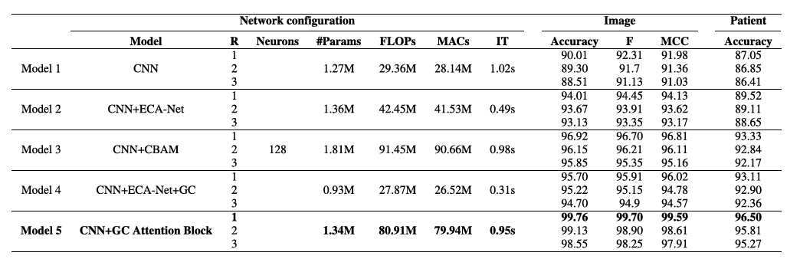
EXPERIMENTAL SETTINGS:
Fig. Performance evaluation for different Network configurations of scratch CNN where R, IT, F, MCC for the residual unit, inference time, F1-score,Matthews correlation coefficient, respectively

Slide 13
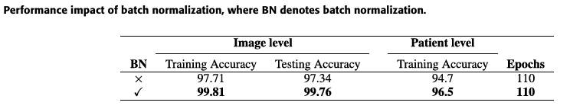
Team number-22

Slide 14
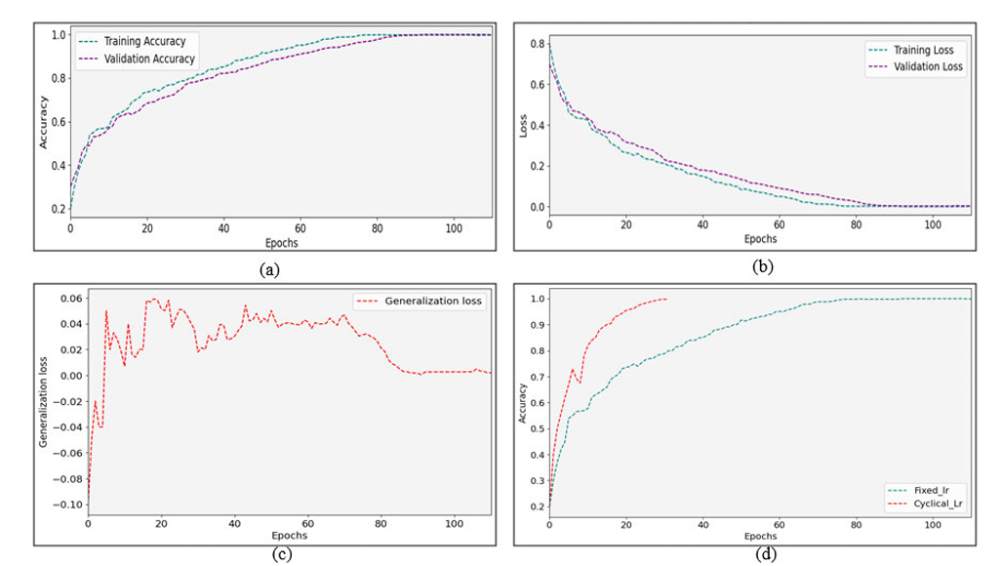
ANALYSIS OF RESULTS:-
Fig: Combined dataset outcomes. (a) : Accuracy comparison curve (fixed lr).(b): Loss comparison curve (fixed lr). (c): Generalization loss curve (fixed lr), which is the gap between validation and training loss. (d): Observation of super convergence (validation accuracy).

Slide 15
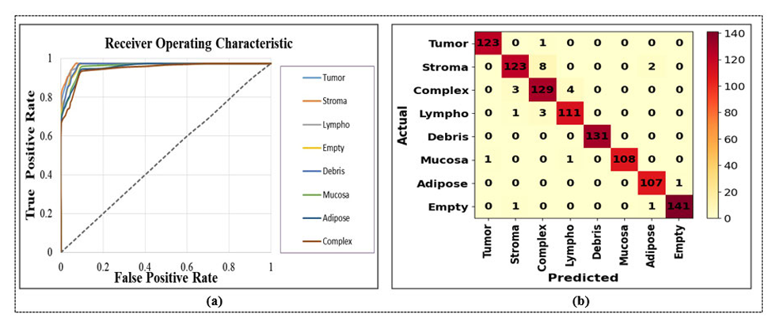

Slide 16
ADVANTAGES:-
The advantages of this project includes:-
Enhanced Classification Accuracy: The GC Attention Module improves both image-level (99.76%) and patient-level (96.5%) accuracy, setting a new benchmark for cancer detection in histopathological images.
Effective Handling of Imbalanced Datasets: Utilizes GANs to augment data, improving model performance on imbalanced datasets.
Superior Evaluation Metrics: Delivers high F1-score (99.7%) and MCC (99.59%), ensuring robust and reliable results.
Efficient Model Performance:The model reduces computational resources significantly, with 0.47 million fewer parameters, 10.72 million fewer MACs, and 0.03s reduced inference time, making it both faster and more resource-efficient.

Slide 17
Team number-22
CONCLUSION:
The project demonstrates a significant advancement in the classification of lung and colon cancer histopathological images by introducing the GC Attention Module for CNNs. This novel approach enhances both image-level and patient-level accuracy, achieving exceptional results (99.76% and 96.5%, respectively). Additionally, the model improves computational efficiency, reducing parameters and inference time. By leveraging GANs for dataset expansion and incorporating advanced evaluation metrics such as F1-score and MCC, the model shows its robustness, particularly for imbalanced datasets. This work paves the way for future improvements in histopathological image analysis and personalized medicine by integrating multi-modal data sources.

Slide 18
REFERENCES:-
[1] International Angry for Research on Cancer. (2020). World Fact Sheet. Accessed: 26, 2022. [Online]. Available: https://gco.iarc. fr/today/data/factsheets/populations/900-world-fact-sheets.pdf
[28] W. Shen, M. Zhou, F. Yang, D. Yu, D. Dong, C. Yang, Y. Zang, and J. Tian, ‘‘Multi-crop convolutional neural networks for lung nodule malignancy suspiciousness classification,’’ Pattern Recognit., vol. 61, pp. 663–673, Jan. 2017
[37] X. Zhu, K. Guo, T. Qiu, H. Fang, Z. Wu, X. Tan, and C. Liu, ‘‘Stereoscopic image super-resolution with interactive memory learning,’’ Exp. Syst. Appl., vol. 227, Oct. 2023, Art. no. 120143. [38] M. Liang, Z. Ren, J. Yang, W. Feng, and B. Li

Slide 19

Team number-22

